Slide 1

Information and Communication Technologies
By Ticherafi zineddine les members du groups:
Dahmani Mohamed anis
Akram ouabid
Machane yanis
NEDER Mohamed El Hocine

Slide 2
Plan of the report:
Introduction on TIC (Information and Communication Technologies)
Evolution of ICT
Google Services
Microsoft Tools
Git and GitHub
Artificial Intelligence (AI) and Machine Learning (ML)
Impact of ICT and Related Technologies
Challenges and Future Trends
Conclusion

Slide 3
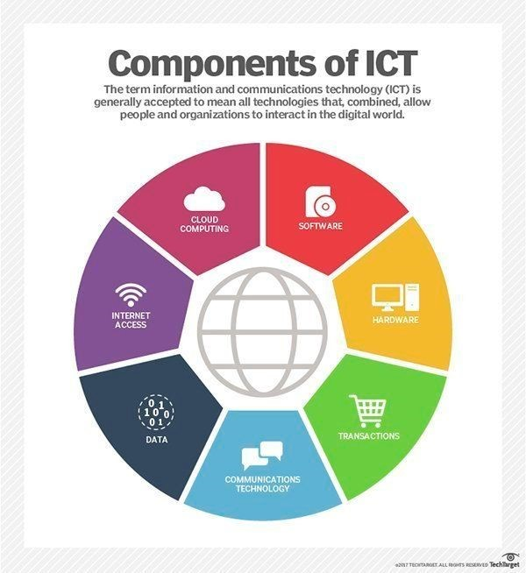
1- Intro in TIC
- Information and Communication Technologies (ICT) encompass a broad array of technologies that facilitate communication, information sharing, and data management. This report aims to explore the evolution,
significance, and impact of ICT, focusing on prominent
tools and services offered by industry giants such as
Google, Microsoft, Git, and GitHub.

Slide 4

2- Evolution of ICT
The evolution of Information and Communication Technologies (ICT) spans several decades and has been marked by significant milestones that have reshaped how individuals, businesses, and societies interact with technology. The evolution can be traced through key developments in various domains:
Early Computing Era
Proliferation of Personal Computers
Internet Revolution
Mobile Technology and Connectivity
Cloud Computing and Big Data
IoT (Internet of Things) and AI (Artificial Intelligence)
Blockchain and Distributed Ledger Technology
Throughout this evolution, ICT has continually evolved to meet the growing demands of society, businesses, and technological advancements. It has facilitated globalization, improved communication, streamlined processes, enhanced productivity, and brought about innovative solutions to complex problems.

Slide 5
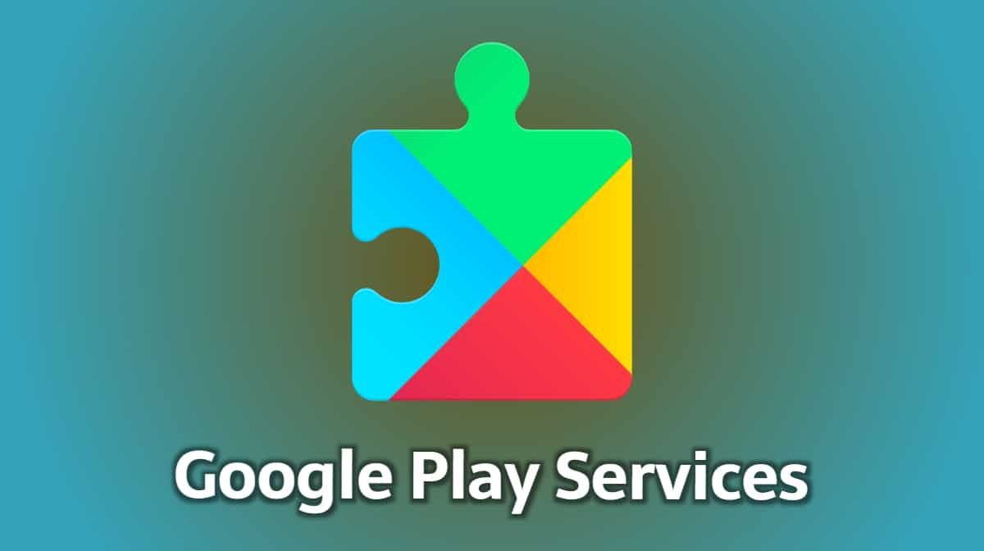
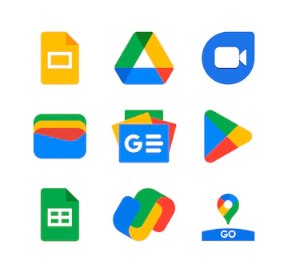
3- Google Services
Google offers a comprehensive suite of services and products that have become an integral part of daily life for billions of users around the world. These services span various categories, including search, productivity tools, communication, cloud computing, entertainment, and more. Here are some of the prominent Google services:
Google Search
Gmail
Google Drive
Google Docs, Sheets, and Slides
Google Maps
Google Chrome
Google Meet
Google's services have revolutionized how individuals and businesses operate by providing accessible, user-friendly, and innovative tools for communication, productivity, information access, and entertainment. The integration and synchronization among these services create a cohesive ecosystem that enhances user experiences across different devices and platforms.

Slide 6
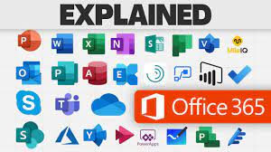

4- Microsoft Tools
Microsoft offers a broad spectrum of tools and software solutions that cater to various needs, including productivity, collaboration, development, and more. Here are some of the notable Microsoft tools:
Microsoft Office Suite:
Microsoft Word
Microsoft Excel
Microsoft PowerPoint
Microsoft Outlook
Microsoft Access
Microsoft 365 (formerly Office 365):
Microsoft 365 is a subscription-based service that offers access to the Office suite along with cloud-based services such as OneDrive (cloud storage), Microsoft Teams (collaboration platform), Exchange Online (email hosting), SharePoint Online (document management and collaboration), and more.
Microsoft Teams:
A collaboration platform that combines workplace chat, video meetings, file storage, and application integration. It's widely used for remote work, team communication, and project collaboration.
Azure:
Microsoft Azure is a cloud computing platform that offers various services, including virtual machines, databases, analytics, AI and machine learning, IoT, storage, and more. It provides infrastructure as a service (IaaS), platform as a service (PaaS), and software as a service (SaaS) solutions.

Slide 7


5- Git and GitHub
Git:
Definition: Git is a distributed version control system (VCS) created by Linus Torvalds in 2005. It allows developers to track changes in source code during software development.
Key Features:
Version Control:Git tracks changes made to files over time, allowing developers to revert to earlier versions, merge changes, and collaborate seamlessly.
Branching and Merging: Git enables developers to create branches to work on specific features or fixes independently. Later, they can merge these branches back into the main codebase.
Local and Distributed:Git operates locally on a developer's machine, providing the ability to work offline. It's distributed, meaning each developer has a complete copy of the repository, enhancing redundancy and collaboration.
Speed and Efficiency:Git is known for its speed and efficiency in managing large projects with numerous files and a history of changes.

Slide 8

6- Git and GitHub
GitHub:
Definition: GitHub is a web-based platform launched in 2008 that hosts Git repositories and provides collaboration tools for software development projects.
Key Features:
Hosting Git Repositories: GitHub serves as a hosting service for Git repositories, allowing developers to store their code, collaborate, and manage versions online.
Collaborative Development: GitHub facilitates collaboration through features such as pull requests, issue tracking, code review, and project management tools.
Community and Open Source: It has become a hub for the open-source community, fostering collaboration among developers worldwide. Users can contribute to other projects, create their own, or fork existing repositories to build upon them.
Integrations and Extensions: GitHub integrates with various third-party tools, services, and development environments, enhancing its functionality and ease of use for developers.

Slide 9
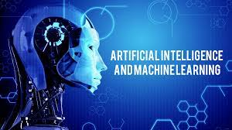
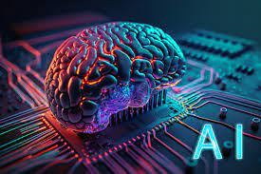
7- AI
Artificial Intelligence (AI) and Machine Learning (ML) represent two rapidly evolving fields that have garnered significant attention and transformed various industries. Here's an overview of AI and ML:
Artificial Intelligence (AI):
Definition: AI refers to the simulation of human intelligence in machines that are programmed to mimic human-like actions, reasoning, problem-solving, and learning. It encompasses a broad spectrum of techniques and technologies aiming to create intelligent systems capable of performing tasks that typically require human intelligence.
Types of AI:
Narrow or Weak AI: | This AI is designed to perform specific tasks
General AI (AGI): | General AI refers to the hypothetical intelligence that demonstrates human-like
Superintelligent AI: | This hypothetical form of AI surpasses human intelligence across all aspects

Slide 10
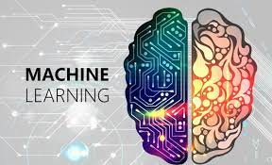
8- ML
Machine Learning (ML):
Definition:ML is a subset of AI that involves the development of algorithms and statistical models that enable machines to improve their performance on a task by learning from data without being explicitly programmed. ML algorithms use patterns and inference to make predictions or decisions.
Types of Machine Learning:
AI and ML technologies continue to advance rapidly, driving innovation and shaping the future of various industries. Their transformative potential, coupled with ethical considerations and societal impacts, underscores the need for responsible development and deployment of AI-powered systems.
Supervised Learning: | In supervised learning, algorithms are trained on labeled datasets,
Unsupervised Learning: | Unsupervised learning involves training algorithms on unlabeled data to identify patterns
Reinforcement Learning: | uses an agent interacting with an environment to learn how to make decisions or take actions by receiving feedback

Slide 11
9- Impact of ICT and Related Technologies
The impact of ICT and associated tools is vast and far-reaching. They have streamlined workflows, enhanced productivity, facilitated global connectivity, and democratized access to information. Businesses leverage these technologies for remote work, seamless collaboration across geographies, and efficient project management. Moreover, they have empowered developers and innovators by providing platforms for code sharing, learning, and community building.

Slide 12
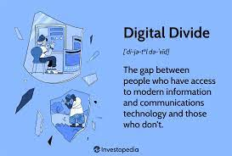

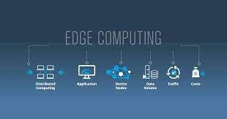
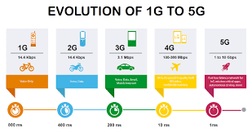
10- Challenges and Future Trends
Challenges and future trends in technology, particularly in the realm of Information and Communication Technologies (ICT), encompass a wide spectrum of considerations that shape the landscape of innovation and its impact. Here are some key challenges and future trends:
Challenges:
Privacy and Data Security
Ethical AI and Bias
Digital Divide
Cybersecurity Threats
Technological Governance and Regulation
Future Trends:
AI and Machine Learning Advancements
Edge Computing Expansion
5G and Connectivity Evolution
Sustainable Technologies
Biotechnology and Health Tech

Slide 13
11- Conclusion
ICT and its related tools and services have fundamentally reshaped how individuals and organizations operate in today's digital age. The continuous evolution and integration of technologies offered by Google, Microsoft, Git, and GitHub have contributed significantly to connectivity, productivity, and collaboration, laying the foundation for further innovation and development in the years to come.

Slide 14
I hope that you liked the project.
THANKS!

